Slide 1

Sinhgad Technical Education Society’s
Smt Kashibai Navale College Of Engineering
Department of Computer Engineering
Academic Year: 2020-21
Presentation on:- Summer Internship GUIDED BY : PRESENTED BY :
Prof. Priyanka Raikar Manthan Yelpale Assistant Professor SKNCOE , Pune SKNCOE , Pune ROLL NO: C33376

Slide 2
Presentation Content:
Introduction of Company
Internship Technology
Problem Statement
Project Objective
Scope of Web Development
Project Output/Result
Conclusion
Certificate of Internship

Slide 3

Introduction of Company:
Internship at Navodita infotech
Company Services
Machine learning
Web Development
Ethical Hacking
App Development

Slide 4
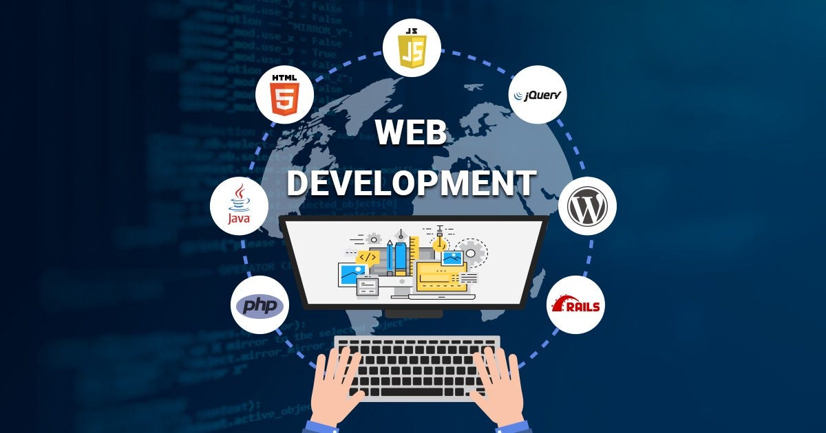
Internship Technology
Web Developer Internship
Front End Development

Slide 5

Problem Statement
Creating a portfolio website using html, css etc.

Slide 6

Project Objective
To showcase my skills and experience through a user-friendly and visually appealing portfolio website.
To demonstrate my proficiency by building a fully functional and responsive portfolio website using
To develop a portfolio website that effectively attracts potential clients in the industry field by showcasing my relevant experience and achievements
To create a portfolio website that serves as a strong foundation for my future career by highlighting my academic achievements and design skills.

Slide 7

Scope of Web Development:
Continuous Technological Evolution
Global Reach and Accessibility
Diverse Range of Projects
Emerging trends
Specializations
Career opportunities

Slide 8
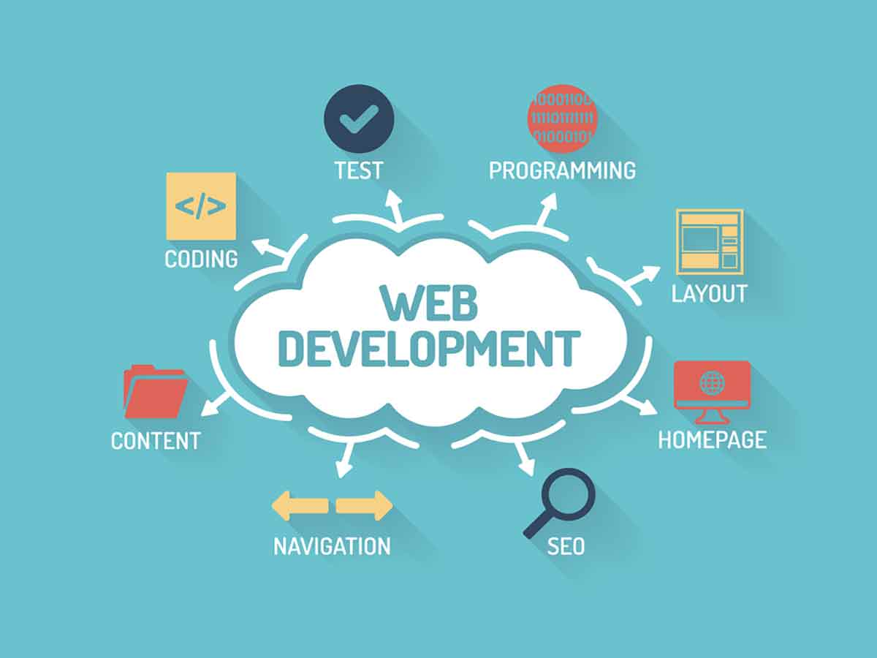
Methodological Details
HTML
CSS

Slide 9
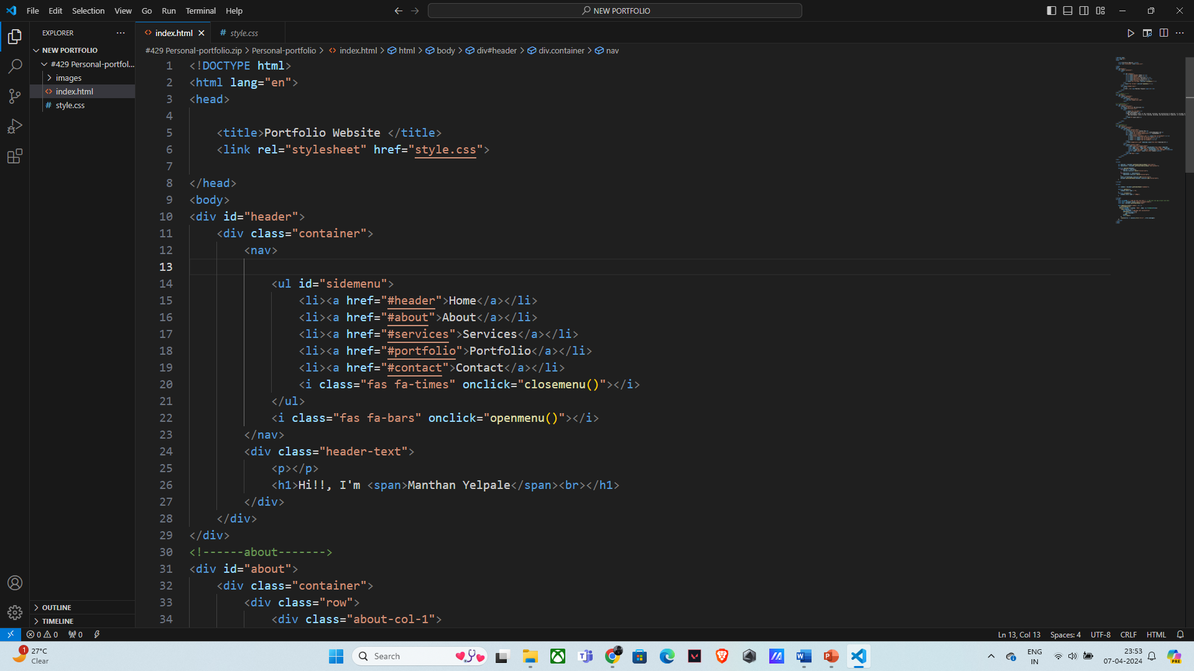
Project Output :

Slide 10
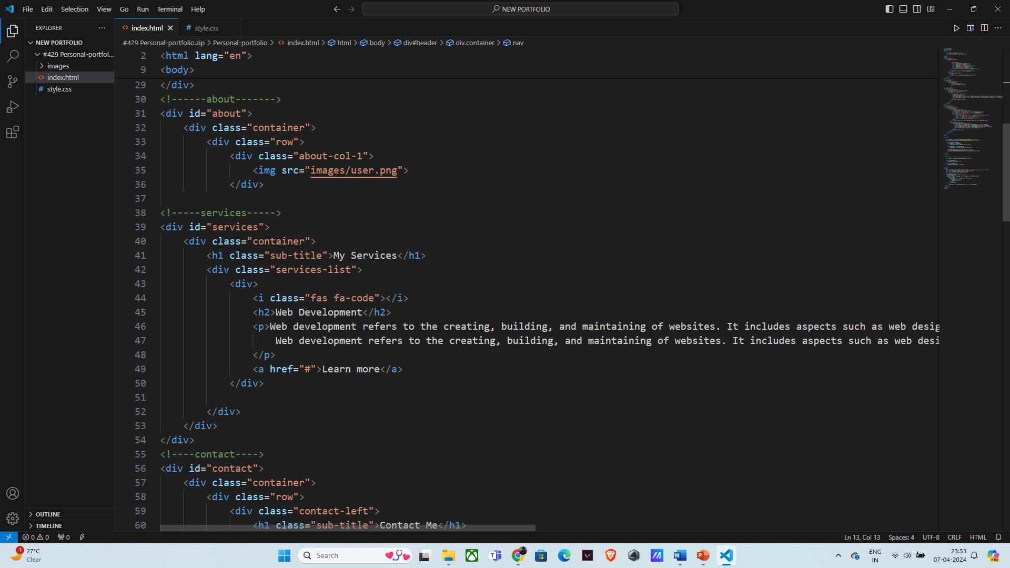
Project Output :

Slide 11
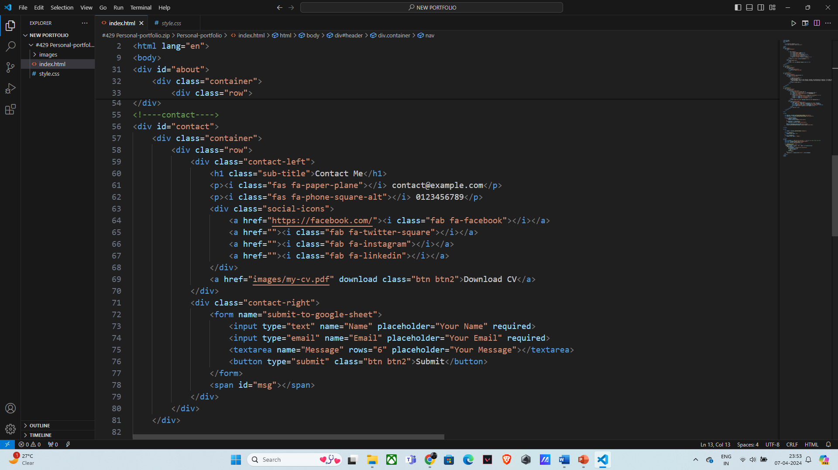
Project Output :

Slide 12
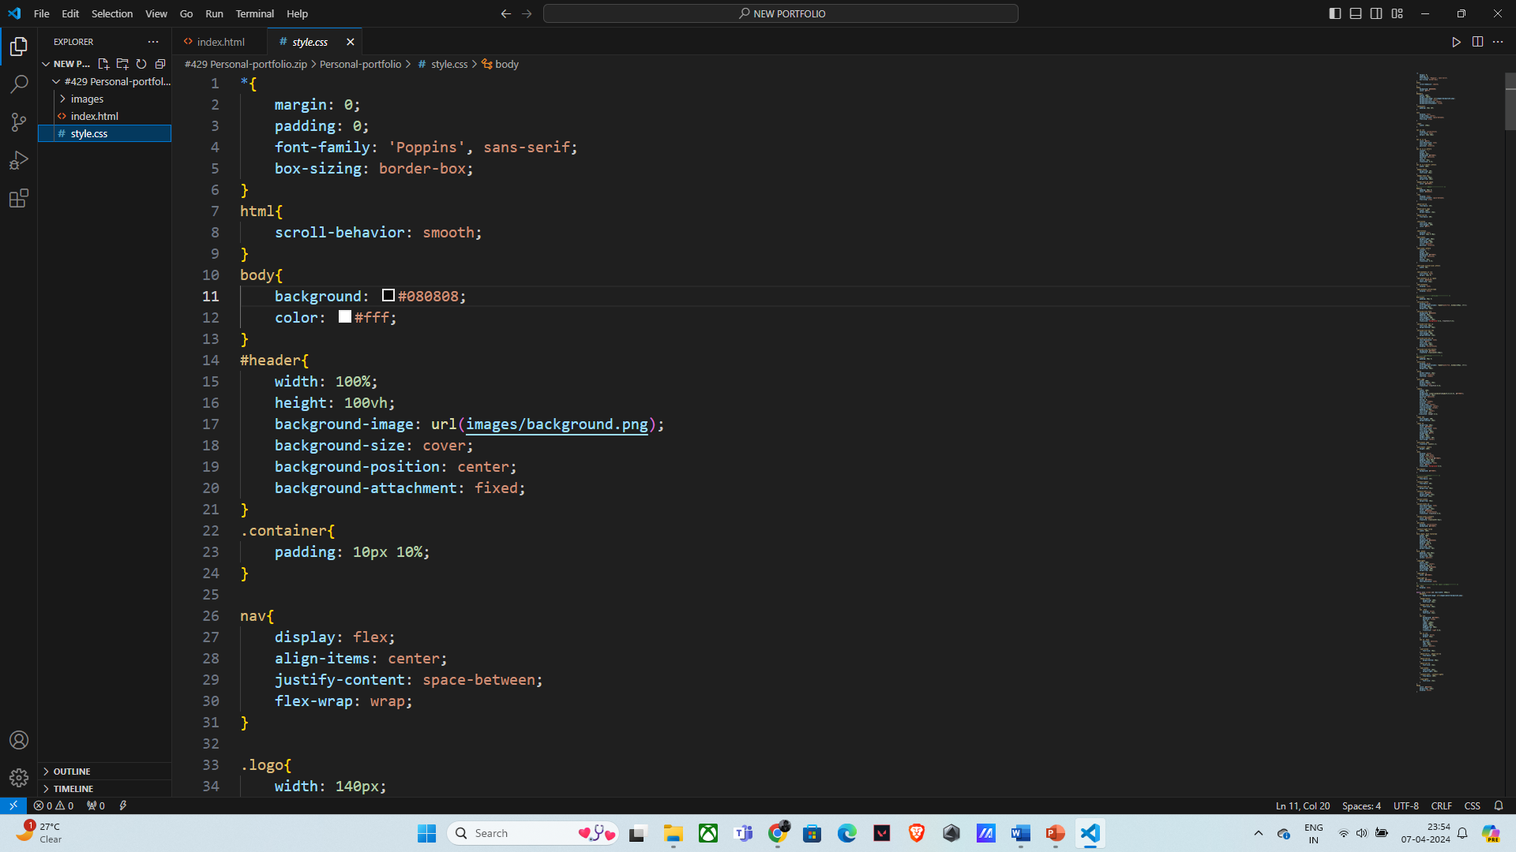
Project Output :

Slide 13
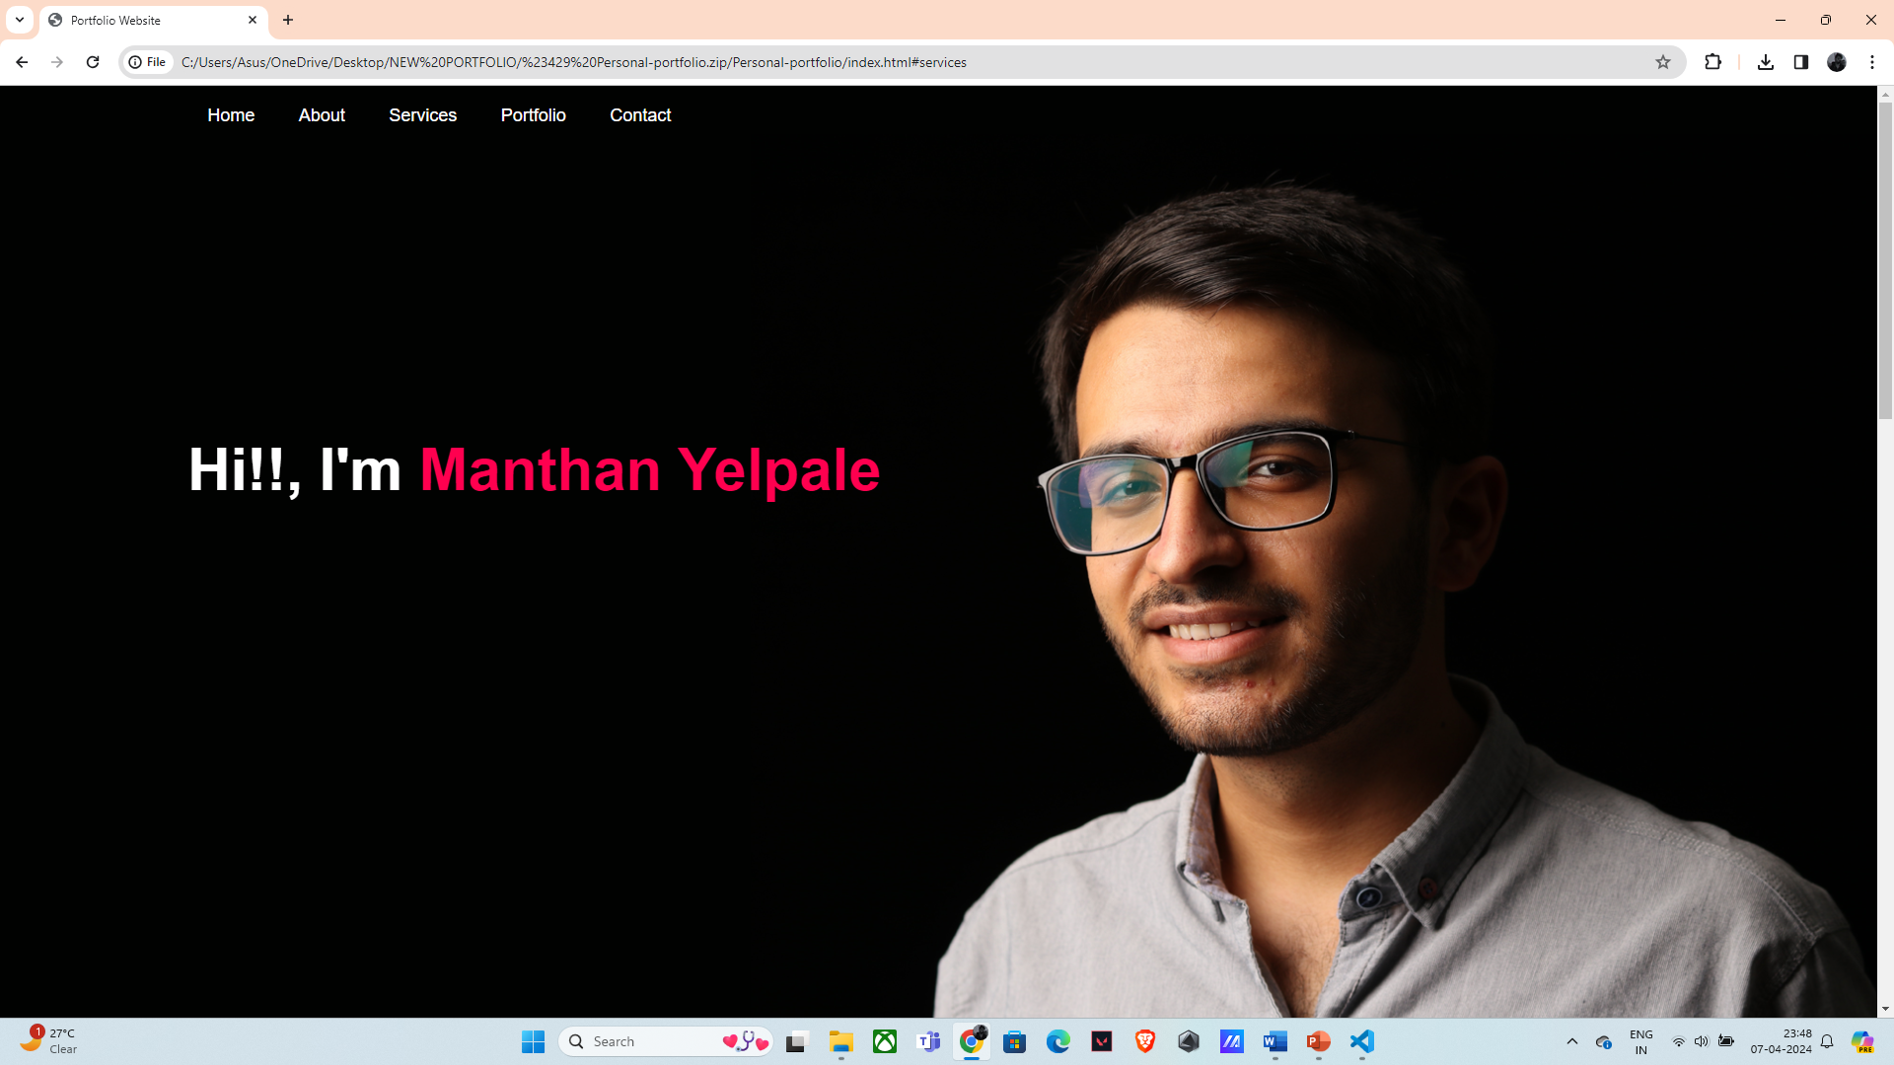
Project Output :

Slide 14
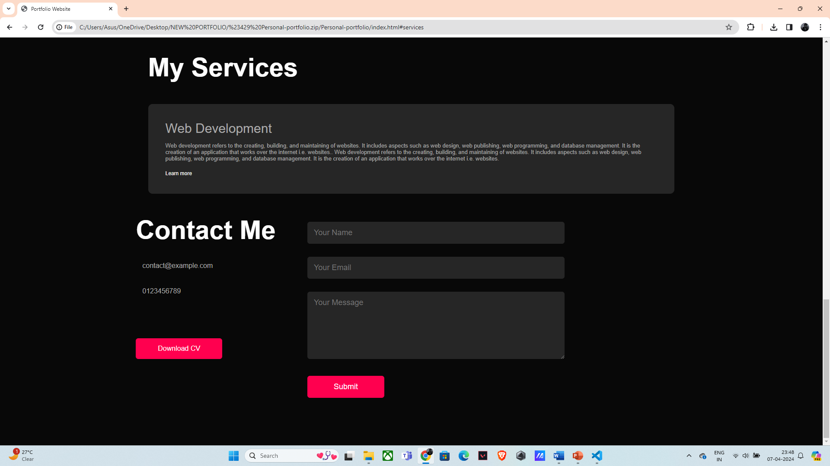
Project Output :

Slide 15
Conclusion:
In conclusion, the successful development of backend APIs for user authentication and vendor package management marks a significant achievement in our internship project.
We have met our objectives by focusing on key areas such as security, scalability, and adherence to industry best practices. This experience has equipped us with valuable skills and insights, and we are poised to continue our journey in web development with a commitment to innovation and excellence.
We extend our thanks to all who supported us throughout this endeavor, and we look forward to applying our knowledge in future projects.

Slide 16
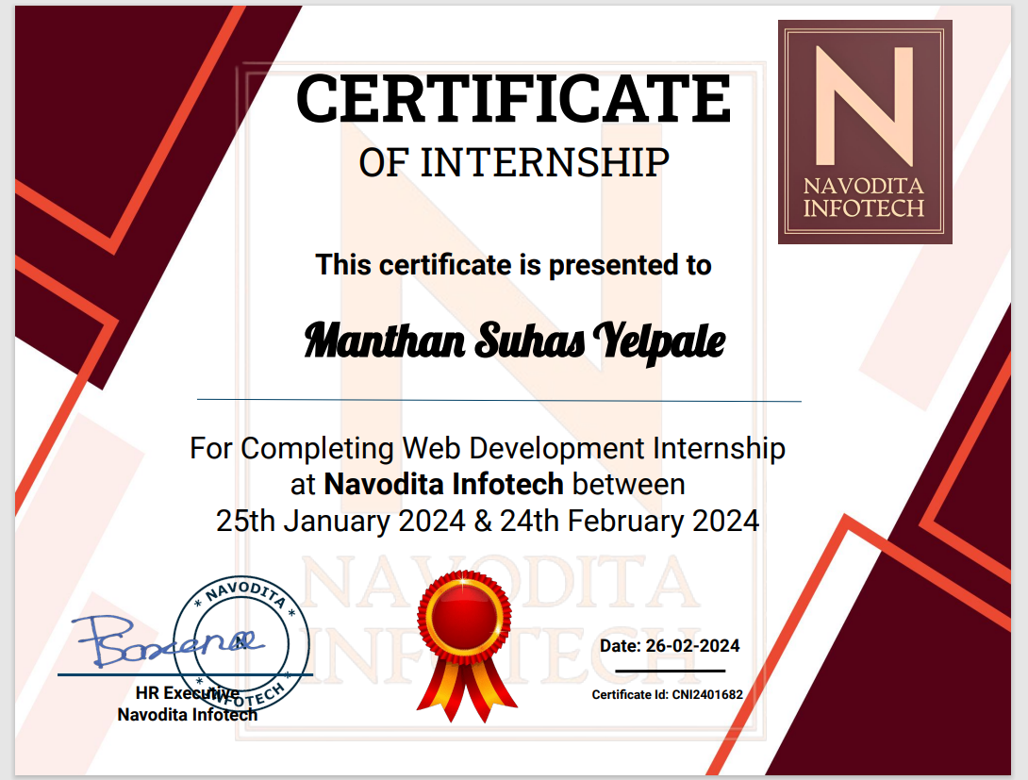

Slide 17
Thank You

